Slide 1
Cascading Style Sheet (CSS)
CSS (Cascading Style Sheets) is a stylesheet language used for describing the presentation and visual layout of a document written in HTML. It controls how elements are displayed on a web page, including aspects like colors, fonts, spacing, alignment, and positioning.
CSS allows web developers to separate the content (HTML) from the design (CSS), making websites more flexible, maintainable, and visually appealing. The term "cascading" refers to the way styles are applied based on their importance and location, with more specific styles overriding general ones.

Slide 2
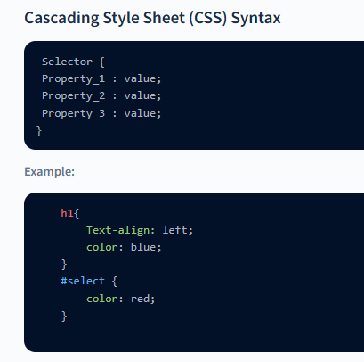
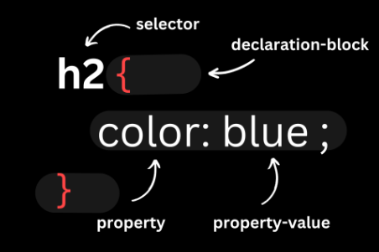

Slide 3




Selectors
The Selectors in CSS are used to select the specific content you want to style. In CSS there are many types of selectors used for selection HTML content, such are:
The Element Selector
The Universal Selectors
Id Selector
Class Selectors

Slide 4
Ways to add CSS
There are three different ways to add CSS to an HTML page, which are:
Inline CSS
Internal CSS
External CSS

Slide 5
Inline CSS:
It is a way of adding a unique style to a particular element.
To use Inline Styles, you can add the style attribute in the relevant HTML tag, and then inside the style attribute, you can provide different styles.
Syntax:
Ex:
<element style="property:value; property:value;"></element>
<h1 style="color: purple;">CWS</h1>

Slide 6
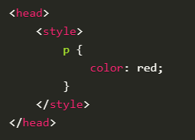
Internal CSS:
Internal CSS is used under one single HTML page. For inserting internal CSS, we place the whole CSS style inside the head tag of HTML by using the <style> tag.
But, inserting CSS inline or internal or internal are , not efficient. What if we want to use the same CSS for multiple web pages? If we use the inline or internal insertion method, there will be a lot of redundancy. So, to avoid that issue, we have external CSS.

Slide 7

External CSS :
External CSS works similarly to internal CSS but with a twist. Instead of adding the styles within the HTML file, we create a separate file with .css extension. This file will hold all the styling details. Then, we link this file to the HTML page.
<link>: This tag is used to create links between different resources, like stylesheets, fonts, and more. In our case, we are using a link tag to link the CSS file with the HTML file.
rel="stylesheet": rel stands for relationship, this defines the type of relationship between the HTML document and the linked resource. When set to "stylesheet", it specifies that the linked resource is a stylesheet that will be used to style the HTML content.
href="style.css" : The href attribute stands for "hypertext reference." It specifies the path or URL to the external resource we want to link. In this case, it's the path to the external CSS file called "style.css".

